Slide 1
INF10025
Data Management and Analytics
Lecture 8 – Part 2
Modelling
M:M relationships
SQL: Outer Joins, SubQueries,
Unions, Views

Slide 2
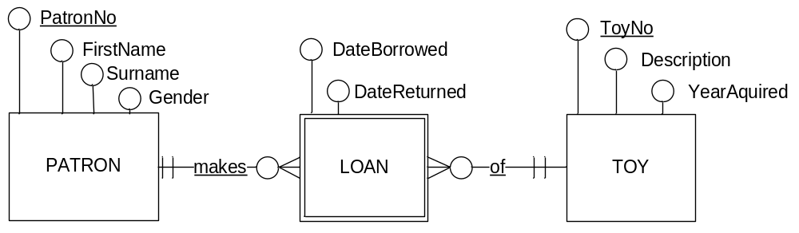
Conversion to Relational Schema
The ERD translates to the following relational schema:
PATRON (PatronNo, Name, Gender)
    PK: PatronNo
    TOY( ToyNo, Description, YearAquired)
    PK: ToyNo
    LOAN( PatronNo, ToyNo, DateBorrowed, DateReturned)
    PK: PatronNo, ToyNo
    FK1: PatronNo references PATRON
    FK2: ToyNo references TOY
Is this correct??? Find out by testing with some sample data…

Slide 3
Testing the ERD
Generate some sample data for the Strong Entities
  PatronNo 53 Sofia Vergara Female
  PatronNo 71 Alex Dyson Male
  ToyNo 27 Rocking Horse 2013
  ToyNo 31 Spinning Top 2014
Generate some sample data for the Weak Entity
  PatronNo ToyNo DateBorrow DateReturn
  53 27 1 June 8 June
  53 31 1 June 8 June
  53 27 19 July 30 July

Slide 4


Does the ERD match business rules
Can you see a problem with the 3rd Loan transaction?
  PatronNo ToyNo DateBorrow DateReturn
  53 27 1 June 8 June
  53 31 1 June 8 June
  53 27 19 July 30 July
The PK of the 3rd row is a duplicate! This will cause an error.
This schema will not allow a Patron to Borrow any toy more than once.
It seems that the
current identifier of LOAN
is incorrect / inadequate.

Slide 5
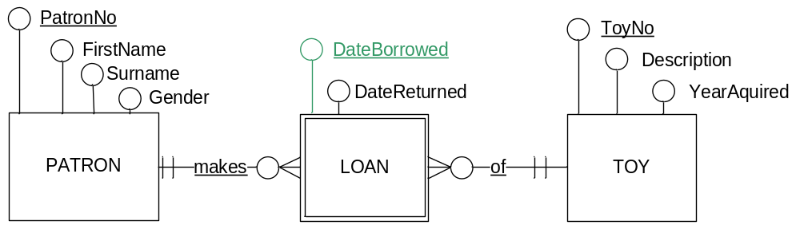
Testing Identifiers
A patron must be able to borrow the same toy on multiple dates.
So underline the DateBorrowed attribute.
The identifier is now PatronNo + ToyNo + DateBorrowed
    Is this ERD correct? Test it with sample data …

Slide 6
Testing Identifiers
The relational schema for Loan is now:
    LOAN( PatronNo, ToyNo, DateBorrowed, DateReturned)
    PK: PatronNo, ToyNo, DateBorrowed
    FK1: PatronNo references PATRON
    FK2: ToyNo references TOY
Test the following Loan data rows. Will they be valid?
  PatronNo ToyNo DateBorrow DateReturn
  53 27 1 June 8 June
  53 31 1 June 8 June
  53 27 19 July 30 July
  53 27 2 August
  71 27 11 June 18 June
  71 31 11 June 18 June
  71 28 31 July 30 August
  53 31 9 October

Slide 7
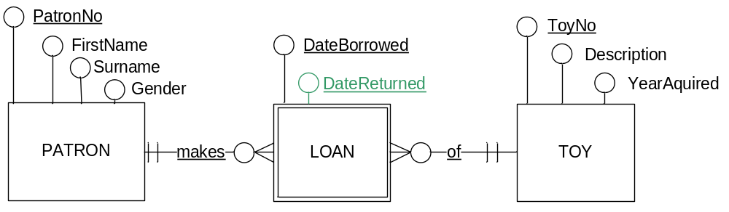
Keep testing…
Would the ERD still be correct if we included DateReturned as part of the Loan Identifier?
Three possible answers exist
      DateReturned should be part of Loan identifier
      DateReturned must not be part of Loan identifier
      It makes no difference to the outcome / usage

Slide 8
Testing Identifiers again
The relational schema for Loan is now:
    LOAN( PatronNo, ToyNo, DateBorrowed, DateReturned)
    PK: PatronNo, ToyNo, DateBorrowed, DateReturned
    FK1: PatronNo references PATRON
    FK2: ToyNo references TOY
Test the following Loan data rows. Will they be valid?
  PatronNo ToyNo DateBorrow DateReturn
  53 27 1 June 8 June
  53 27 19 July 30 July
  53 27 2 August
A PK must not contain Nulls
Row 3 fails this test.

Slide 9
SQL: Multiple Topics
The following slides describe a number of SQL statements and clauses the we will consider to be 'advanced'.
Students hoping to secure only a Pass in this unit will not have to attempt these questions in PASS submission requirements or in Test number 2
Students seeking a higher grade should try some or all of the following:
        Date functions
        Outer Joins
        Sub Queries
        Unions
        Constraints

Slide 10
SQL: Dates using Oracle
Some simple examples of using the Date Datatype within Oracle
CREATE TABLE STUDENT (
stuID NUMBER Primary Key
, birthdate DATE
);
INSERT using DD-MON-YYYY date format
INSERT INTO STUDENT (stuid, birthdate)
VALUES (100, '21-MAY-1996' );
Oracle default date format
INSERT using OTHER date format
INSERT INTO STUDENT (stuid, birthdate)
VALUES (100, TO_DATE( '21/05/1996', 'dd/mm/yyyy') );
With the TO_DATE function
You may specify the format of the incoming date

Slide 11
SQL: Dates using Oracle
Some simple query examples of using the Date Datatype within Oracle
SELECT using DD-MON-YYYY date format
SELECT * FROM STUDENT WHERE birthdate = '21-MAY-1996';
SELECT using OTHER date format
SELECT * FROM STUDENT
WHERE birthdate >= (TO_DATE( '01/01/1996', 'dd/mm/yyyy')
AND birthdate <= (TO_DATE( '31/12/2016', 'dd/mm/yyyy')
);

Slide 12
SQL: SubQueries
We have already examined the AVG aggregate function.
  E.g. SELECT AVG(runtime) From Movie;
  --calculates the average movie length
Suppose we need to find all movies longer than the average.
You might try this:
  SELECT * FROM MOVIE
  WHERE runtime > AVG(runtime);
This is incorrect.
Aggregation functions are NOT permitted in the WHERE clause.
Why?
  An aggregation function must be evaluated in the context of its own query.
  Solution: use a subquery.
✗

Slide 13
SQL:Subqueries Example 1
A SUBQUERY is a complete SQL statement that is placed WITHIN an existing SQL statement.
  Subqueries are often used when a result cannot be calculated by a single SQL statement. (The outcome requires two or more SQL statements)
  Subqueries ARE permitted within the WHERE clause.
  The subquery is evaluated first (takes precedence) because it is in brackets.
  The subquery is executed ONCE. It is not executed separately for every row.
  SELECT *
  FROM MOVIE
WHERE runtime > ( SELECT AVG(runtime)
FROM MOVIE );

Slide 14
SQL: Sub Queries dissected
  SELECT *
  FROM movie
  WHERE runtime > ( SELECT AVG(runtime) FROM movie ) ;
The subquery is evaluated first because it is in brackets.
  See BODMAS http://www.mathsisfun.com/operation-order-bodmas.html
This subquery returns a single value
For each row in the movie table, the runtime value is compared to the value returned by the subquery.

Slide 15
SQL:Subqueries Example 2
Find the movie with the longest duration.
First, determine the query to find the longest duration
  SELECT MAX(runtime)
  FROM MOVIE;
Now write the other code that interacts with the subquery
  SELECT *
  FROM MOVIE
  WHERE runtime = ( result of subquery );
  Put it all together in a single statement
  SELECT *
  FROM MOVIE
  WHERE runtime = ( SELECT MAX(runtime)
  FROM MOVIE
  );

Slide 16

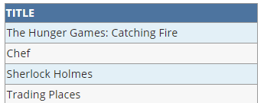
SQL:Subqueries Example 3
“Find all movies with Canadian Actors”
Sub Query with Where In
First, determine actor numbers of actors born in Canada
  SELECT actorno FROM actor WHERE bornin = 'Canada';
Now write the other code that interacts with the subquery
  SELECT m.title
  FROM movie m
  INNER JOIN casting c
  ON m.movieno = c.movieno
  WHERE actorno IN ( result of subquery );
  Put it all together in a single statement
  SELECT m.title
  FROM movie m INNER JOIN casting c
  ON m.movieno = c.movieno
  WHERE actorno IN (SELECT actorno FROM actor WHERE bornin = 'Canada');

Slide 17


SQL:Subqueries Example 4
“Which rating codes have an average runtime greater than the average runtime for all movies?”
Sub Query in the Having clause
First, determine the query to find average runtime
  SELECT AVG(runtime) FROM movie;
Now write the other code that interacts with the subquery
  SELECT rating_code, AVG(runtime)
  FROM movie
  GROUP BY rating_code
  HAVING AVG(runtime) > ( result of subquery );
  Put it all together in a single statement
  SELECT rating_code, AVG(runtime)
  FROM movie
  GROUP BY rating_code
  HAVING AVG(runtime) > (SELECT AVG(runtime) FROM movie;
  https://www.essentialsql.com/get-ready-to-learn-sql-server-19-introduction-to-sub-queries/

Slide 18
Types of Joins
Consider the data in table 1 and table 2.
Assume there is a PK:FK relationship between the tables.
A Select statement with an inner join gets data where PK=FK
Table 1
Table 2
Dave
Sue
Emma
Jennifer
Taylor
Sophie
Jaden
Taylor
Sophie
Jaden
Noah
Amelia
Jackson
Lucas
INNER JOIN
An INNER JOIN uses
Values that have a match in both tables

Slide 19
SQL: Inner Joins
  SELECT a.fullname, c.movieno
  FROM actor a
  INNER JOIN casting c
  ON c.actorno = a.actorno
  ORDER BY a.fullname;
Business Requirement:
"Provide a list showing all actors.
List the movies that each appears in"
Actor Table
Movie Table
ActorNo | Fullname
102 | Brad Pitt
104 | Robert Downey Jr
106 | Amy Adams
108 | Natalie Portman
MovieNo | Title
711 | V for Vendetta
721 | La La Land
731 | Black Swan
745 | Iron Man
Casting Table
ActorNo | MovieNo
104 | 745
106 | 721
108 | 731
108 | 711
  Result Set:
  Fullname MovieNo
  Amy Adams 721
  Natalie Portman 731
  Natalie Portman 711
  Robert Downey Jr 745
What has happened to Brad Pitt?
He is NOT in the result set!
Requirement is not met.

Slide 20
LEFT OUTER JOIN
Imagine that we want all rows from Table 1
and all matching rows from Table 2.
This is known as a LEFT OUTER JOIN (because table 1 is on the left!)
Table 1
Table 2
Dave
Sue
Emma
Jennifer
Taylor
Sophie
Jaden
Taylor
Sophie
Jaden
Noah
Amelia
Jackson
Lucas
LEFT OUTER JOIN
A LEFT OUTER JOIN uses
All values from LEFT table plus
values that have a match in both tables

Slide 21
SQL: Outer Joins
The 'left' table is the first table listed
Business Requirement:
"Provide a list showing all actors.
List the movies that each appears in"
  SELECT a.fullname, c.movieno
  FROM actor a
  LEFT OUTER JOIN casting c
  ON c.actorno = a.actorno
  ORDER BY a.fullname;
Actor Table
Movie Table
ActorNo | Fullname
102 | Brad Pitt
104 | Robert Downey Jr
106 | Amy Adams
108 | Natalie Portman
MovieNo | Title
711 | V for Vendetta
721 | La La Land
731 | Black Swan
745 | Iron Man
Casting Table
ActorNo | MovieNo
104 | 745
106 | 721
108 | 731
108 | 711
  Result Set:
  Fullname MovieNo
  Amy Adams 721
  Brad Pitt
  Natalie Portman 731
  Natalie Portman 711
  Robert Downey Jr 745
The Outer Join causes
actor 102 (BP) to be listed even
though he is not in the
intersection entity

Slide 22
RIGHT OUTER JOIN
Imagine that we want all rows from Table 2
and matching rows from Table 1.
This is known as a RIGHT OUTER JOIN
Table 1
Table 2
Dave
Sue
Emma
Jennifer
Taylor
Sophie
Jaden
Taylor
Sophie
Jaden
Noah
Amelia
Jackson
Lucas
RIGHT OUTER JOIN
A RIGHT OUTER JOIN uses
all values from RIGHT table plus
values that have a match in both tables

Slide 23
SQL: Outer Joins
The 'right' table is the second table listed
Business Requirement:
"Provide a list showing all actors.
List the movies that each appears in"
  SELECT a.fullname, c.movieno
  FROM casting c
  RIGHT OUTER JOIN actor a
  ON c.actorno = a.actorno
  ORDER BY a.fullname;
Actor Table
Movie Table
ActorNo | Fullname
102 | Brad Pitt
104 | Robert Downey Jr
106 | Amy Adams
108 | Natalie Portman
MovieNo | Title
711 | V for Vendetta
721 | La La Land
731 | Black Swan
745 | Iron Man
Casting Table
ActorNo | MovieNo
104 | 745
106 | 721
108 | 731
108 | 711
  Result Set:
  Fullname MovieNo
  Amy Adams 721
  Brad Pitt
  Natalie Portman 731
  Natalie Portman 711
  Robert Downey Jr 745
The outcome is identical to a
LEFT outer join.
LEFT or RIGHT depends on
the order of table names.

Slide 24
SQL: Inner & Outer Joins
The Inner Join gathers data
from casting and movie.
The Outer Join then adds
the fullname of ALL actors
  SELECT a.fullname, c.movieno, m.title
  FROM casting c
  INNER JOIN movie m
  ON c.movieno = m.movieno
  RIGHT OUTER JOIN actor a
  ON c.actorno = a.actorno
  ORDER BY a.actorno;
Actor Table
Movie Table
ActorNo | Fullname
102 | Brad Pitt
104 | Robert Downey Jr
106 | Amy Adams
108 | Natalie Portman
MovieNo | Title
711 | V for Vendetta
721 | La La Land
731 | Black Swan
745 | Iron Man
Casting Table
ActorNo | MovieNo
104 | 745
106 | 721
108 | 731
108 | 711
  Result Set:
  Fullname MovieNo Title
  Amy Adams 721 La La Land
  Brad Pitt
  Natalie Portman 731 Black Swan
  Natalie Portman 711 V for Vendetta
  Robert Downey Jr 745 Iron Man

